Slide 1
Counting
Lecture 3
Discrete Mathematical Structures

Slide 2
At the Last Class …
Part I: Propositional and Predicate Logic
  Logical operations and truth tables
  Quantifiers
  Logic statements
Part II: Methods of Proof
  Rules of inference
  Indirect method of proof
  Proof by contradiction
  Disproving by counterexamples

Slide 3
Counting
Part I: Basics of Combinatorics
  Permutations
  Combinations
  Pigeonhole principles
Part II: Some Techniques for Analysis
  Elements of probability
  Recurrence relations

Slide 4
Countable Set
A set A is countable if and only if we can arrange all of its elements in a linear list in a definite order.
  “Definite” means that we can specify the first, second, third element, and so on.
  If the list ended and with the nth element as its last element, it is finite.
  If the list goes on forever, it is infinite.

Slide 5
Proof of Countability
The set of all integers is countable.
  We can arrange all integer in a linear list as follows:
  0,-1,1,-2,2,-3,3,...
  that is: positive k is the (2k+1)th element, and
  negative k is the 2kth element in the list.

Slide 6

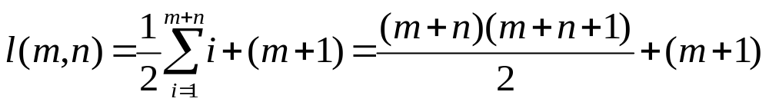
Set of Ordered Pairs
The set of all objects with the form <i,j> is countable, where i,j are nonnegative integers.
...
<0,0> <1,0> <2,0> <3,0> <4,0>
<0,1> <1,1> <2,1> <3,1>
<0,2> <1,2> <2,2>
<0,3> <1,3>
<0,4>
...
...
...
<0,0>, <0,1>, <1,0>, <0,2>, <1,1>, <2,0>, <0,3>, ......

Slide 7
Real Number Set Is Not Countable
(0,1) is not a countable set
  “diagonal proof”
  Assuming that elements in (0,1) can be listed linearly：
  0.b₁₁b₁₂b₁₃b₁₄…
  0.b₂₁b₂₂b₂₃b₂₄…
  0.b₃₁b₃₂b₃₃b₃₄…
  0.b₄₁b₄₂b₄₃b₄₄…
  ⋮
  then 0. b₁b₂b₃b₄…（b_{i}≠b_{ii}）can’t be in the above list.
So, it is impossible to arrange all real number in a linear list.

Slide 8

What Color will be the Next?
Black? White?
What’s the next?

Slide 9
Pigeonhole Principle
If n pigeons are assigned to m pigeonholes, and m<n, then at least one pigeonhole contains two or more pigeons.
  Proof by contradiction:
  Suppose each pigeonhole contains at most 1 pigeon. Then at most m pigeons have been assigned. Since m<n, so n-m>0, there are (n-m) pigeons have not been assigned. It’s a contradiction.

Slide 10
Pigeonhole by Odd Factor
Problem: show that if any 11 numbers are chosen from the set {1,2,...,20}, then one of them will be a multiple of another.
Solution:
  Observation: every natural number n can be represented as 2^{k}m, where m is the largest odd factor of n, k is a nonnegative integer.
  Let each odd number in {1,2,...,20} correspond to a pigeonhole, then there are 10.
  Each element in {1,2,...,20} corresponds to a pigeon, and there are 20.
  If n₁, n₂ are in one pigeonhole, then one of them must be the multiple of another.

Slide 11
Not Too Far Apart
Problem: We have a region bounded by a regular hexagon whose sides are of length 1 unit. Show that if any seven points are chosen in this region, then two of them must be no farther apart than 1 unit.
The region can be divided into six equilateral triangles, then among 7 points randomly chosen in this region must be two located within one triangle.

Slide 12
Bad Way to Assign Team Code
Situation: Shirts numbered consecutively from 1 to 20 are worn by the 20 members of a bowling league. When any three of these members are chosen to be a team, the sum of their shirt number is to be used as the team code.
Problem: show that if any 8 of the 20 are selected, then from these 8 members one may form at least 2 different teams having the same team code.
Solution: Possible teams are the pigeon, and there are 56(C₈³), and possible code numbers are pigeonhole, there are only 52(the least is 1+2+3=6, and the largest is 18+19+20=57).

Slide 13
Shaking Hands at a Gathering
Situation: at a gathering of n people, everyone shaked hands with at least one person, and no one shaked hand more than once with the same person.
Problem: show that there must have been at least two of them who had the same number of handshaking.
Solution:
  Pigeon: the n participants
  Pigeonhole: different number between 1 and n-1.

Slide 14
Extended Pigeonhole Principle
If n pigeons are assigned to m pigeonholes, then one of the pigeonholes must contain at least ⎣(n-1)/m⎦+1 pigeons.
  Proof by contradiction
  If each pigeonhole contains no more than
  ⎣(n-1)/m⎦ , then there are at most m ⎣(n-1)/m⎦
  ≤n-1 pigeons at all. It’s a contradiction.

Slide 15
Knowing Each Other or Not
Problem: show that among any 6 persons, there are 3 who know
each other, or there are 3 who don’t know any two others.
Pigeonhole 1: those knowing A
B
C
There must be at least 3 elements which fall into one of the two pigeonhole.
D
A
not knowing each other
knowing each other
Pigeonhole 2：those not knowing A

Slide 16
Hidden Pigeons and Invisible Pigeonholes
Situation: A chess player wants to prepare for a championship match by playing some practice games in 77 days. She wants to play at least one game a day but no more than 132 games altogether.
Problem: show that no matter how she schedules the games there is a period of consecutive days within which she plays exactly 21 games.

Slide 17
Scheduling the Practice Games: Solution
Let a_{i} denote the total number of games she plays up through the ith day. Then, a₁, a₂, a₃,..., a₇₆, a₇₇ is a monotonically increasing sequence, with a₁≥1, and a₇₇≤132.
Note: if a_{i}+21= a_{j} then the player plays 21 games during the days i+1, i+2, up through j .
Considering the sequence:
a₁, a₂, a₃,..., a₇₆, a₇₇, a₁+21, a₂+21, a₃+21, ..., a₇₆+21 a₇₇+21
The least element in the sequence is 1, and the largest is 153. However, there are 154 elements in the sequence, so, there must be at least two elements having the same value.
Note that both the first and second half sequences are monotonically increasing, so, it is impossible for the two elements having the same value to be within one half sequence, that is, we have a_{i}+21= a_{j}

Slide 18


Probabilistic Event
11 different outcomes
An event, for example:
“no less than 8”
Sample spaces:
what you want to record
number pattern:
{(i,j)|1≤i,j≤6}
sum of number:
{2,3,4,...,11,12}
Two one’s:
{yes, no}
Experiment: throwing two dices

Slide 19
Probability of an Event
Probability of an event E is a number, denoted as p(E), reflecting one’s assessment of the likelihood that the event will occur.
If the event E has occurred n_{E} times after n trials of the underlying experiment. Then f_{E}=n_{E}/n is called the frequency of occurrence of E in n trials.
If we believe that the fraction f_{E} will tend ever closer to a certain number as n becomes larger, p(E) is the number.

Slide 20
Axioms for a probability space
Some properties the assigned probability should satisfy: (let A is the sample space)
  P1: 0≤p(E)≤1 for every event E in A
  P2: p(A)=1 and p(Ø)=0
  P3: p(E₁∪E₂∪…∪E_{k})=p(E₁)+p(E₂)+…+p(E_{k}) whenever the events are mutually exclusive.
For a given experiment and a specific sample space, if the probabilities are assigned to all events with P1-P3 satisfied, we get a probability space.

Slide 21
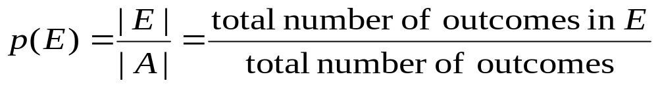
Finite Probability Space
There are only finite outcomes.
Each outcomes indivually consists an elementary event.
  For one coin toss, there are two outcomes – head and tail. “Head” is an elementary event.
The probability of an elementary event corresponds a specific outcome.
If all outcomes are equally likely, then the probability of an event E can be computed as:

Slide 22
A Fair Six-sided Die
Toss it 3 times. What is the probability of the event “either all three numbers are equal or none of them is a 4”?
Equally likely outcome is a reasonable assumption
The size of the sample space is 6³=216
Let F be the event of “all three numbers are equal”, the |F|=6 (F={111,222,…,666})
Let G be the event “none of them is a 4”, the |G|=5³=125 (G is the combination of any 3 from {1,2,3,5,6})
|F∪G|=|F|+|G|-|F∩G|=6+125-5=126
So, the result is 126/216 = 7/12
This is a special case of so-called inclusion-exclusion principle

Slide 23
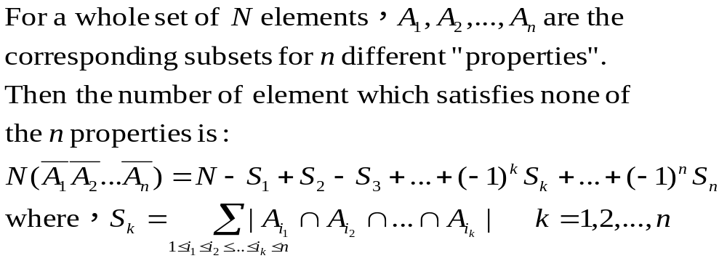

Principle of Inclusion and Exclusion
For an example：the formula for 4 subsets
N - (|S₁|- |S₂|+ |S₃|+ |S₄|)
+ (|S₁∩S₂|+|S₁∩S₂|+|S₁∩S₄|+|S₂∩S₃|+|S₂∩S₄|+|S₃∩S₄|)
- (|S₁∩S₂∩S₃|+|S₁∩S₂∩S₄|+|S₁∩S₃∩S₄|+|S₂∩S₃∩S₄|)
+ |S₁∩S₂∩S₃∩S₄|

Slide 24
Hatcheck Problem
A new employee checks the hats of n people at a restaurant, forgetting to put claim check numbers on the hat. When customers return for their hats, the checker gives them back at random from the remaining hats. What is the probability that no one receives the correct hat?
Mathematical model: arrange 1,2,3,…,n randomly, resulting in a new sequence i₁, i₂, i₃,…,i_{n}. What is the probability that for any k(1≤k≤n), i_{k}≠k？
The resulting sequence is called a derangement.

Slide 25
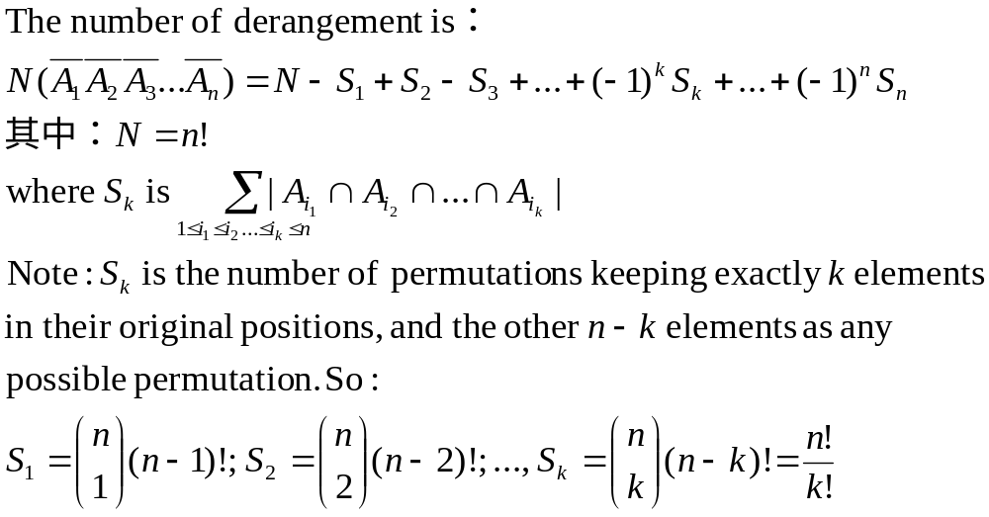
Number of Derangement
Define i_{k}=k as Property A_{k} , and A_{k} is used for the subset of all permutations satisfying property A_{k}.

Slide 26
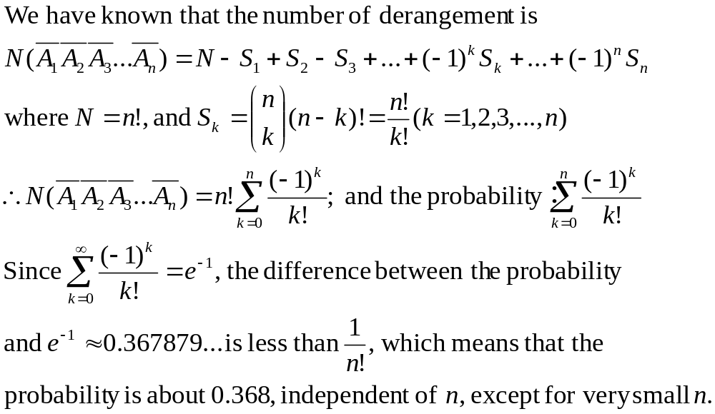
The Probability of Derangement

Slide 27

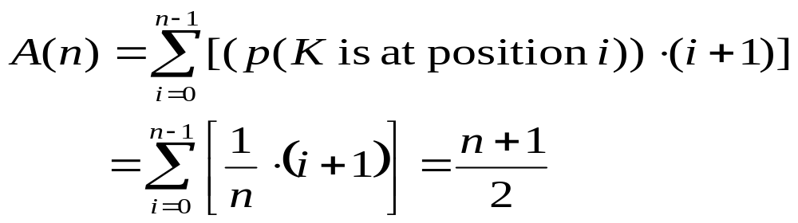
Average Behavior of an Algorithm
Sequential search a list of n items for K
  Assuming no same entries in the list, and K does occur in the list
  Look all inputs with K in the ith location as one input (so, inputs totaling n)
  Each input occurs with equal probability (i.e. 1/n)

Slide 28
Probabilistic Paradox
For a family of four children, is it most likely there are two boys and two girls? (It is assumed that each child has a equal chance to be male or female at his/her birth)
The probability of the event of 2-2 is 6/16, and the probability of the event of 1-3 is 8/16

Slide 29
The Twin Paradox
By the Pigeonhole Principle, we know that among 367 persons, there must be two persons who have the same day as their birthday.
A professor bet before a class of 50 students that there are two students with the same day as their birthday. What the chance that he won the bet?

Slide 30
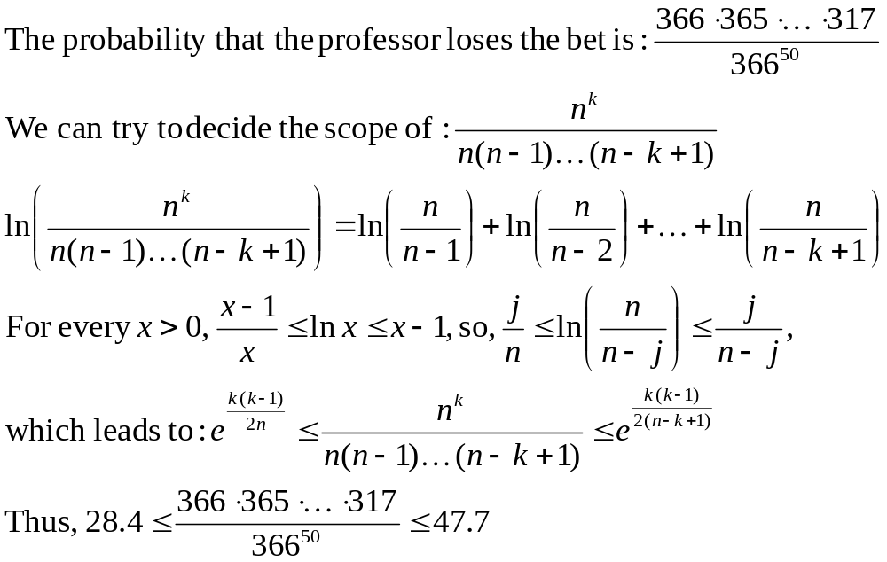
Good chance for the professor
This means that:
The professor will lose only one (or two time) in 28 years, if he bets at each of his class.

Slide 31
Thinking Recursively: Problem 1
Towers of Hanoi
  How many moves are need to move all the disks to the third peg by moving only one at a time and never placing a disk on top of a smaller one.
T(1) = 1
T(n) = 2T(n-1) +1

Slide 32

Solution of Towers of Hanoi
  T(n) = 2T(n-1) + 1
  2T(n-1) = 4T(n-2) + 2
  4T(n-2) = 8T(n-3) + 4
  …….
  2^{n-2}T(2) = 2^{n-1}T(1) + 2^{n-2}
T(n) = 2^{n}-1

Slide 33
Thinking Recursively: Problem 2
Cutting the plane
  How many sections can be generated at most by n straight lines with infinite length.
L(0) = 1
L(n) = L(n-1) +n
Intersecting all n-1 existing lines to get as most sections as possible
Line n

Slide 34
Solution of Cutting the Plane
L(n) = L(n-1)+n
= L(n-2)+(n-1)+n
= L(n-3)+(n-2)+(n-1)+n
= ……
= L(0)+1+2+……+(n-2)+(n-1)+n
L(n) = n(n+1)/2 + 1

Slide 35
Thinking Recursively: Problem 3
Josephus’s problem
  Find the position to live, or die!
For small n:
1, 1, 3, 1, 3, 5, 7, …
×
1
1
×
11
×
2
2
10
×
10
×
3
3
9
×
9
4
8
×
4
×
8
5
7
5
×
7
6
6

Slide 36
Thinking Recursively: Problem 3 (cont.)
J(1) =1
J(2n) = 2J(n)-1
J(2n+1) = 2J(n)+1
Josephus’s problem
  Find the position to live, or die!
1
3
1
2n+1
1
3
11
5
10
2
2
2n-1
3
10
5
3
9
7
9
J(2^{m}+l) =2l+1
8
4
4
8
5
7
5
6
7
6

Slide 37
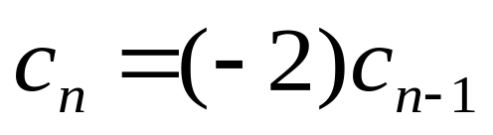
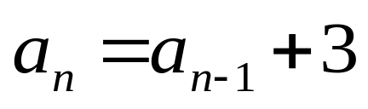
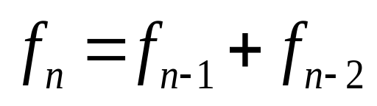
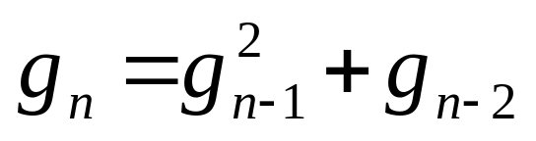
Linear Homogeneous Relation
is called linear homogeneous relation of degree k.
Yes
No

Slide 38
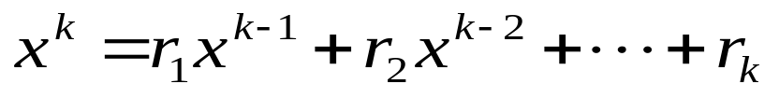
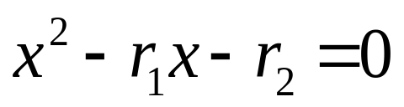
Characteristic Equation
For a linear homogeneous recurrence relation of degree k
the polynonial of degree k
is called its characteristic equation.
The characteristic equation of linear homogeneous recurrence relation of degree 2 is:

Slide 39
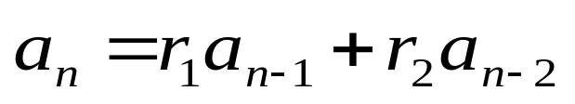
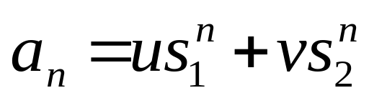
Solution of Recurrence Relation
If the characteristic equation of the recurrence relation has two distinct roots s₁ and s₂, then
where u and v depend on the initial conditions, is the explicit formula for the sequence.
If the equation has a single root s, then, both s₁ and s₂ in the formula above are replaced by s

Slide 40
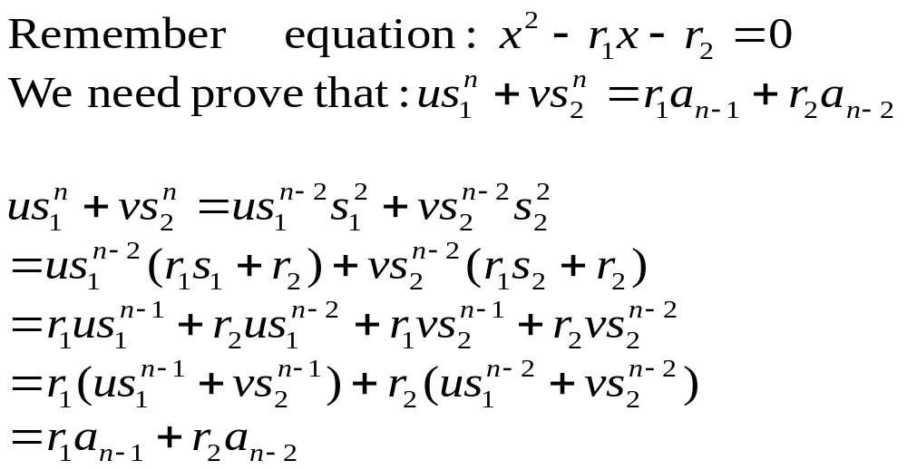
Proof of the Solution
the

Slide 41
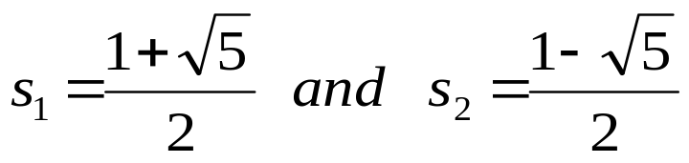
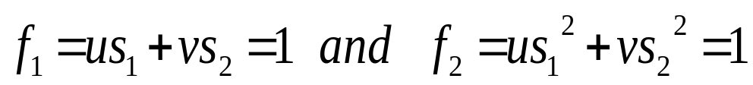
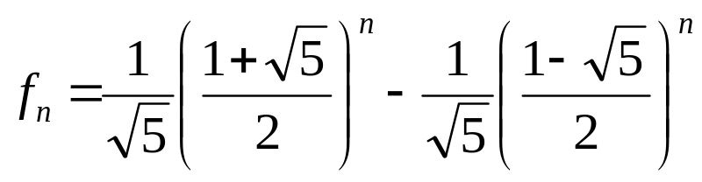
Fibonacci Sequence
f₁=1
f₂=1
f_{n}= f_{n-1}+ f_{n-2}
1, 1, 2, 3, 5, 8, 13, 21, 34, ......
Explicit formula for Fibonacci Sequence
The characteristic equation is x²-x-1=0, which has roots:
Note: (by initial conditions)
which results:

Slide 42
Home Assignments
To be checked
  pp.20: 23-24
  pp.82: 25-26, 29, 34
  pp.86: 19, 23, 32
  pp.90: 5, 10, 12, 17-19, 21-24
  pp.98: 34, 37-40
  pp.104: 14, 16, 18, 24, 28, 34, 36
Self tests

